Slide 1
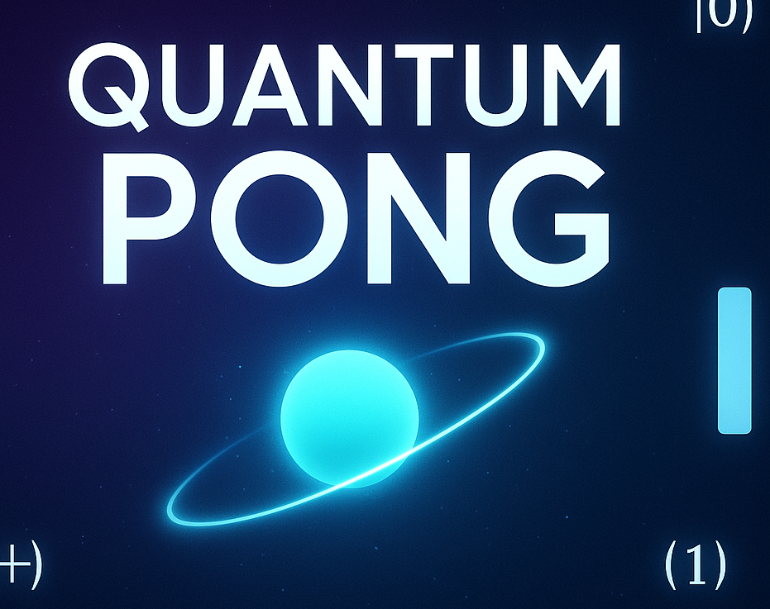
Quantum Pong with Gate Power-Ups
Final Project Presentation
ADEQUATE Quantum Game Course
Muhammad Uzair
29414
m.uzair.29414@khi.iba.edu.pk

Slide 2

Game Overview
A quantum twist on the classic Pong game.
Integrates real quantum concepts into gameplay.
Single-player vs AI opponent.
Quantum behavior directly influences ball dynamics.

Slide 3
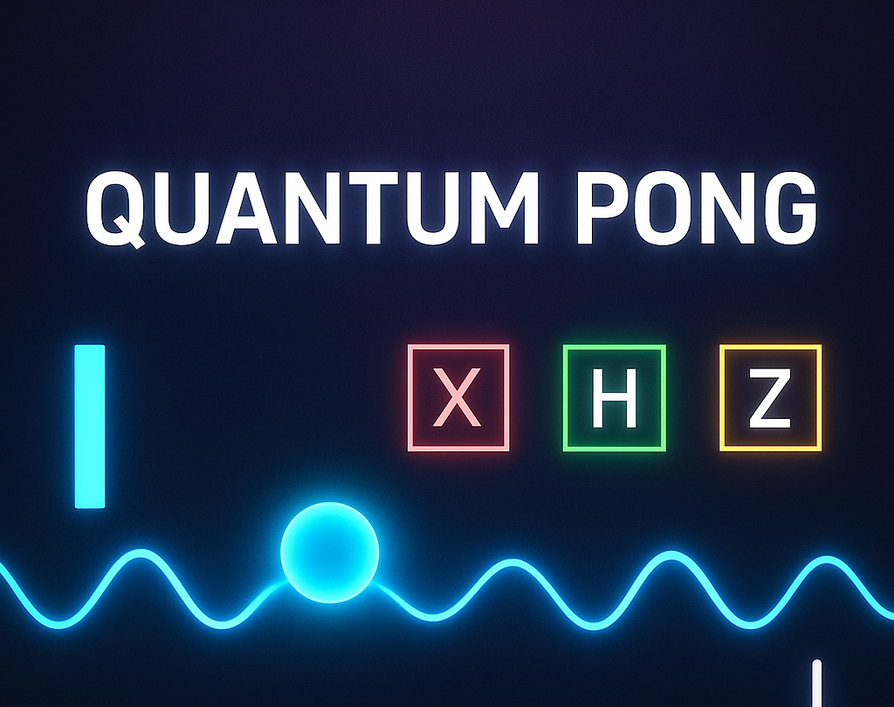
Key Features
- Quantum Gates: H, X, Z gate power-ups
- Superposition mode with dual-ball dynamics
- Quantum collapse with visual feedback
- Z-noise events & measurement collapse
- Score system and opponent AI
- Speed jerks & directional flips on state change

Slide 4
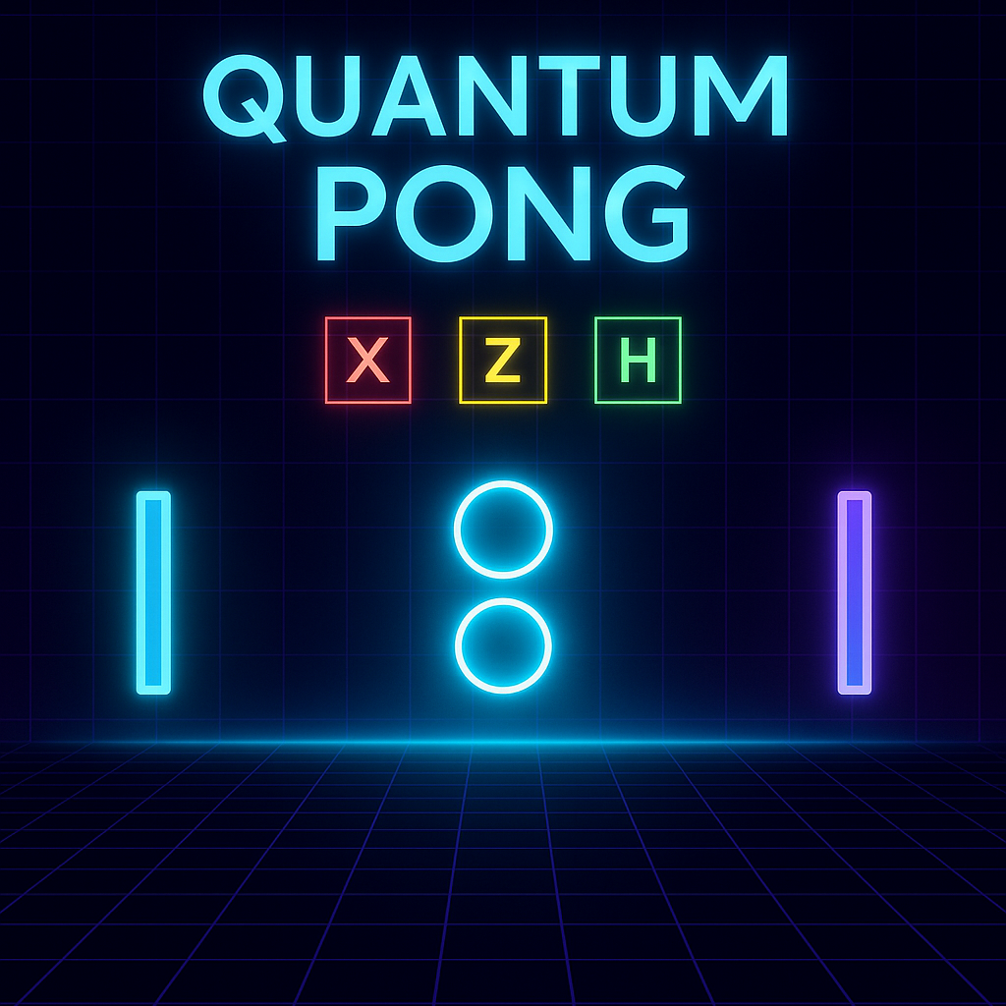
Quantum Concepts Used
• Superposition: H gate spawns two ball paths.
• Measurement: collapse to state |0⟩ or |1⟩ after timeout or paddle hit.
• X Gate: toggles state, flips direction with speed jerk.
• Z Gate: flips vertical direction.
• Noise: random Z-gate behavior simulating decoherence.

Slide 5
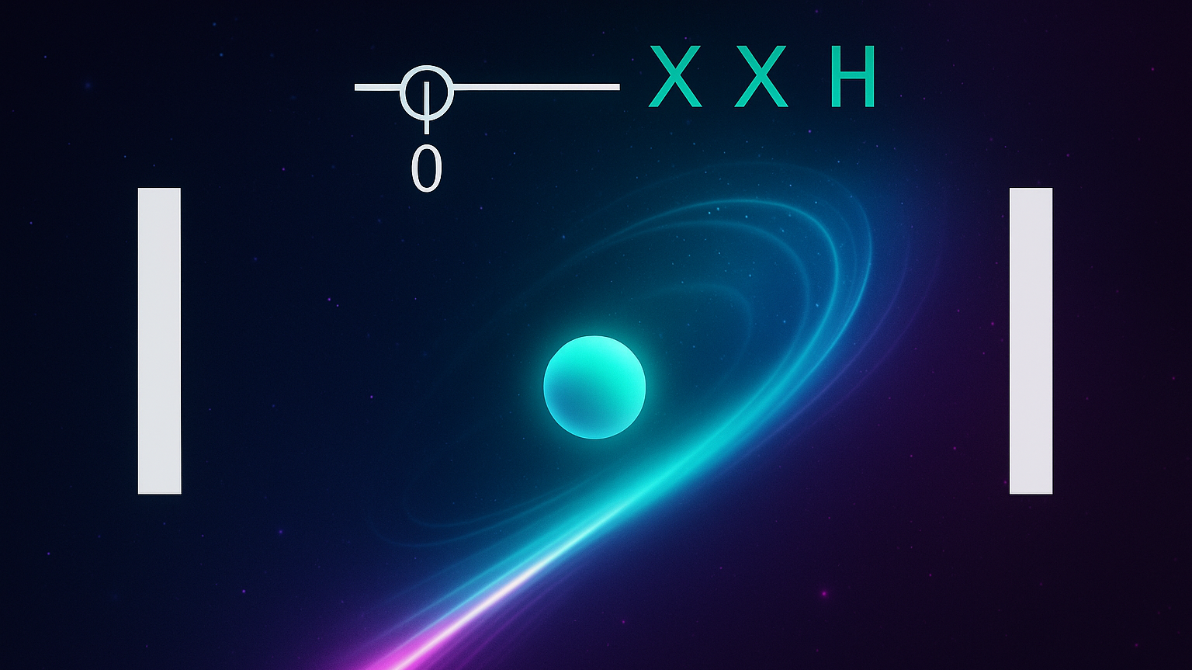
4. How to Play
⬆️⬇️ Arrow keys: Move your paddle
H key: Apply Hadamard gate (enter superposition)
X key: Apply X gate (toggle state)
Z key: Apply Z gate (flip vertical movement)
Catch gate power-ups for automated quantum effects.
Hit the correct ball to collapse and score!

Slide 6

Visual Effects
- Superposition Glow: Light shimmer on dual ball state.
- Collapse Flash: White screen flash on measurement collapse.
- Quantum Glitch: Noise ripples or jerks on gate application.
- Dual Ball Animation: Visible split on H gate.

Slide 7


